Slide 1
Seventh
Cache Me Outside
CS2450 · 2/19/2026

Slide 2
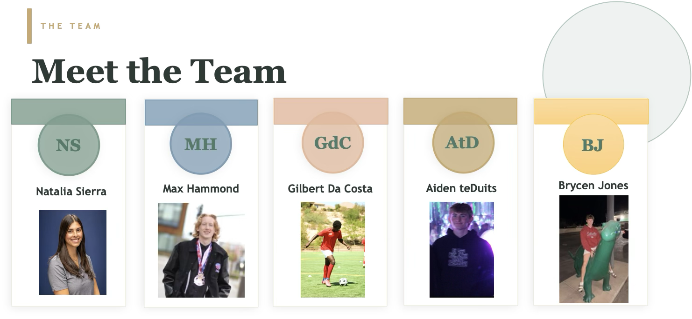

Seventh · Cache Me Outside Natalia Sierra

Slide 3
OVERVIEW
Why Seventh?
Problem
Business Context
Solution
Reflection gets ignored
Short-form platforms
Social media is either ephemeral or too public
Deep writing buried in doom scrolling
Journaling habits difficult to sustain
Force a consistent journaling habit
Raising desire for healthier digital space
Require contribution before consumption
Long-form post sharing built in
Journaling improves clarity, growth
Sunday-only weekly reflections
Friends-first privacy model
Private weekly draft space
Unlock community feed by posting first
No word limit
Seventh · Cache Me Outside
Max & Natalia

Slide 4
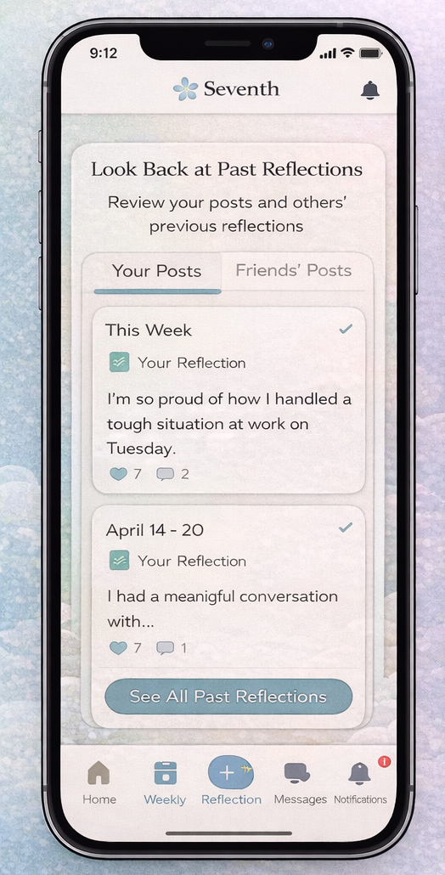
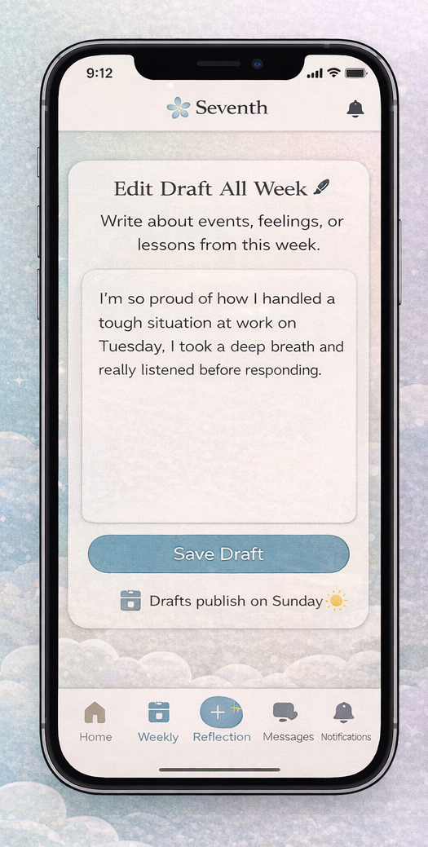
SCOPE
In-Scope 1.0
Edit drafts throughout the week
Posts publish only on Sundays
Restrict viewing until a reflection is posted
Look back on your posts and others' previous posts
Read and comment on others' posts Monday – Saturday
Seventh · Cache Me Outside
Brycen Jones

Slide 5

FUTURE VISION
Out of Scope 1.0
Reflection Circles
Private invite-only groups for grief support, entrepreneurship, students, and more.
Live Sunday Rooms
Mentorship Matching
Audio or video based live reflection sessions, similar to social audio platforms.
Pair users based on life stage, goals, or shared experiences.
Anonymous Mode
Community Challenges
Post anonymously within the community while still requiring a weekly reflection.
Weekly themed prompts — gratitude week, growth week, resilience week.
Seventh · Cache Me Outside
Gilbert Da Costa

Slide 6
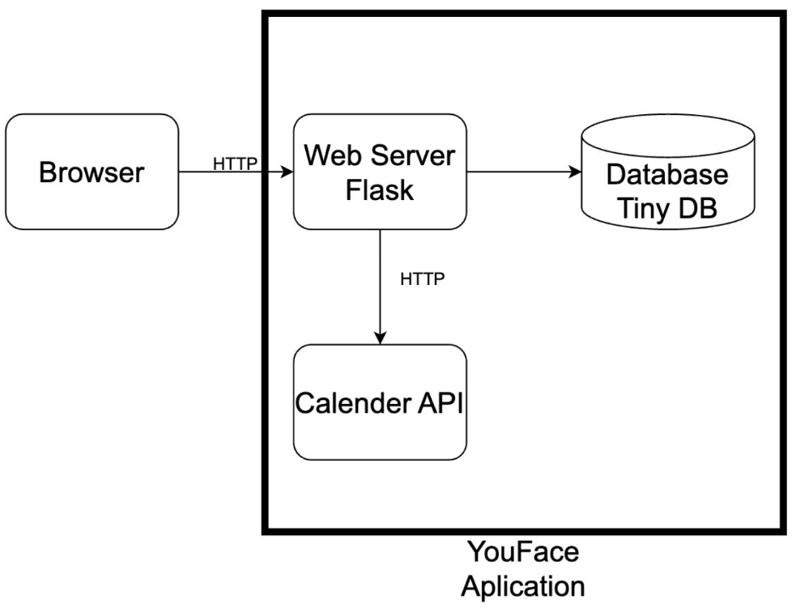
Key Dependencies
ARCHITECTURE
Solution Architecture
Client: Browser → sends HTTP GET/POST
Backend: Flask (Python route handlers)
app.route handlers validate input, call app logic, return HTML/redirects
Server-rendered pages (Jinja templates) + static assets from/static
Data Layer: TinyDB (JSON document DB)
Stores app data locally (users/posts/settings), quick dev with noDB server
External Integration: Google Calendar API
Flask uses Google API client to create and read events; resultsshown in UI and/or stored in TinyDB
CSS Plan: Scrap existing CSS theme
Dependencies: Flask, TinyDB, Google API libs
Seventh · Cache Me Outside Aiden teDuits

Slide 7
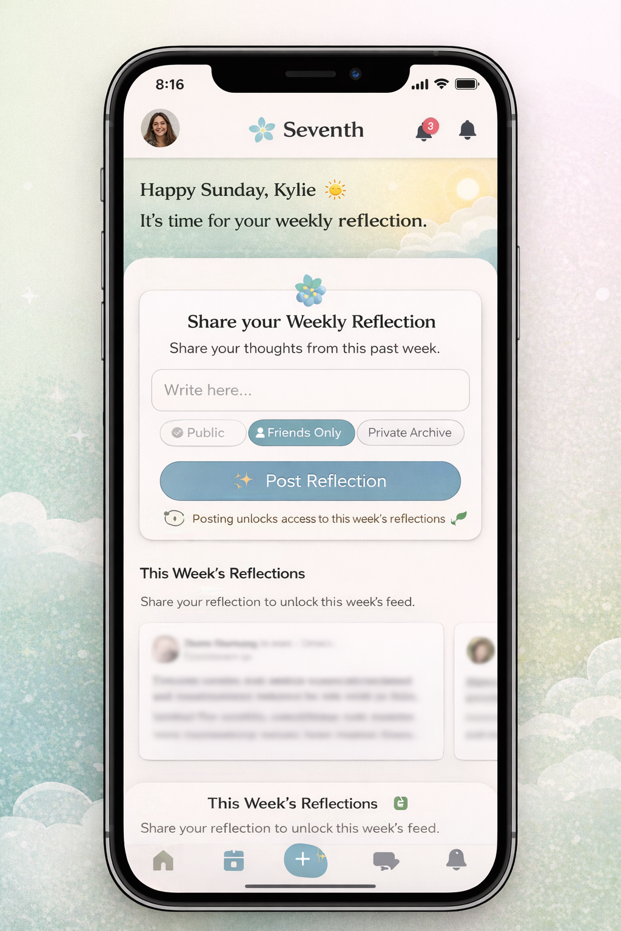
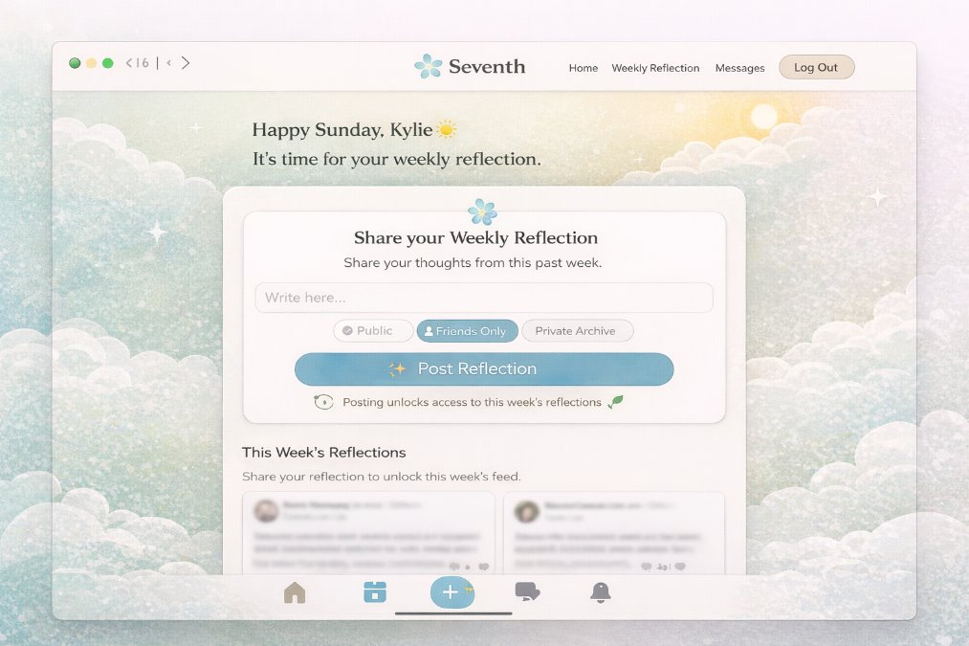
UI MOCKUP
Design Highlights
Seventh · Cache Me Outside Natalia Sierra

Slide 8
Why Seventh Stands Apart
Unique Platform
Social platform makes you contribute before you consume. Seventh flips the model.
Inhibits reflection and growth
Short-form platforms reward speed and reaction. Seventh slows the pace and prioritizes intentional self-awareness.
Positive reinforcement
Weekly rhythm means quality reflections, not daily micro-content.
Built for Real Relationships
Meaningful weekly reflections foster deeper conversations—not surface-level interactions or endless scrolling.
Encouragement and sharing
In-depth sharing with family and friends, not strangers optimizing for likes.
Max & Natalia

Slide 9
Questions?
We would love to hear your thoughts on Seventh.
Cache Me Outside · CS2450 · 2/19/2026
Seventh · Cache Me Outside Aiden teDuits

